Slide 1

Why Study Law?
(please record your answers to each question)

Slide 2

Question 1
How would you best define the term “law”?
Law??

Slide 3

Question 2
Why does almost every modern society have a written code of laws?

Slide 4

Question 3
Are there certain laws that you feel are “unfair” toward people your age (15-18 years old)? If so, name them and explain why you feel this way.

Slide 5
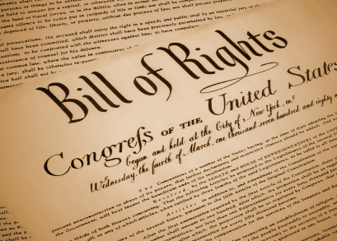
Question 4
Which of the original 10 Constitutional Amendments includes the following rights?
        Congress shall not prohibit nor promote any particular religious belief
        Congress shall not take away the right to free speech
        Congress shall not take away the right to a free press
        Congress shall not take away the right of the people to peacefully assemble
        Congress shall not take away the right of the people to voice their opinion/criticize the government for its actions or inactions

Slide 6


Question 5
A police officer pulls over a 16 year old for doing 55 mph in a 25 mph zone. Does this offense give the officer permission to search the teen’s car or person for drugs? Why or why not?

Slide 7



Question 6
If a current politician lies about having an extra-marital affair and is caught in the lie, is this action serious enough to demand that he or she be legally “removed from office”?
President Clinton
Eliot Spitzer - NY
Larry Craig - MN

Slide 8



Question 7
Does the government have the right to restrict certain content on TV and the radio that may be deemed “obscene”, or does this violate the rights of “free speech” and “free press”?

Slide 9

Question 8
If you commit three separate felonies (serious crimes) in California, do you deserve to go to prison for the rest of your life, without parole?
3
+
=

Slide 10


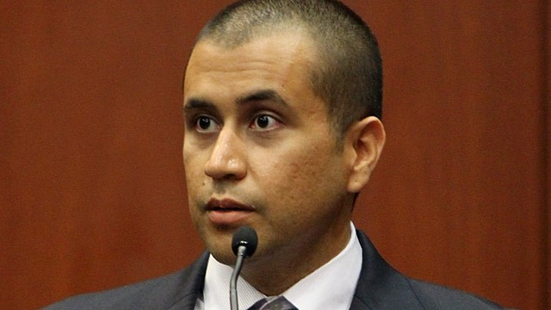
Question 9
Florida has the “Stand your ground” law, which gives citizens the right to use deadly force outside of your home if you feel threatened? Is this a logical law?

Slide 11
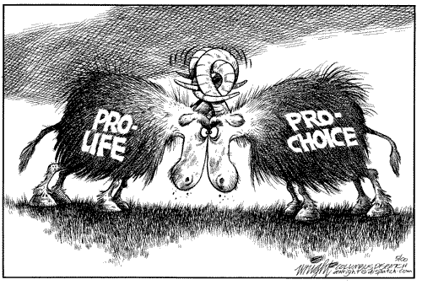


Question 10
In March 2012, the state of Utah passed a law requiring a woman seeking an abortion to go to counseling and then endure a 72 hour waiting period before making the final decision (26 out of 50 states have some type of waiting period). Is this law fair?

